Slide 1
Team C-rious
Simulation Project
Milestone 1
20.04.2023
Manu Benny, Rajesh Bhandari, Teja Sri Lakshmi Balaji Bokka, Madeleine Breitkreutz,
Atif Harshad, Jannis Römermann

Slide 2

Structure
1) About our Team
2) Assessment and Quality Criteria
3) Team Goal
5) Keeping in Touch
6) The Traffic Node
7) Data and Experiments

Slide 3

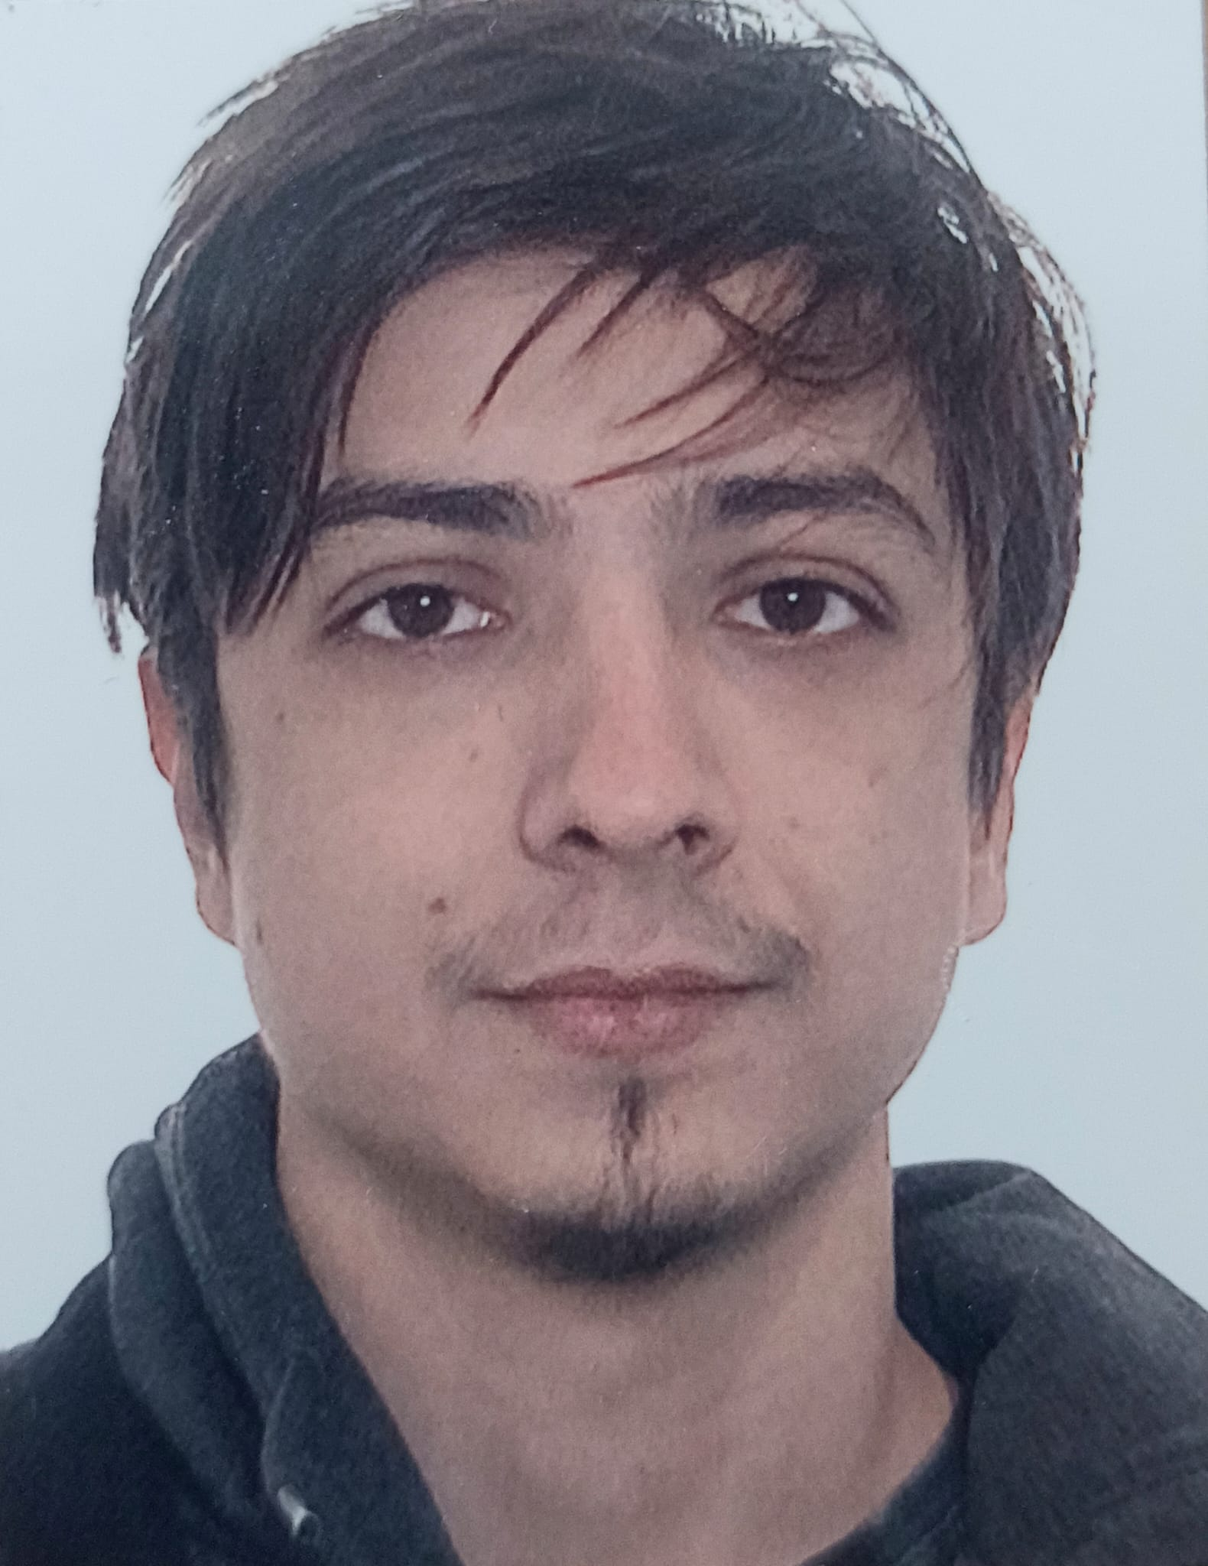
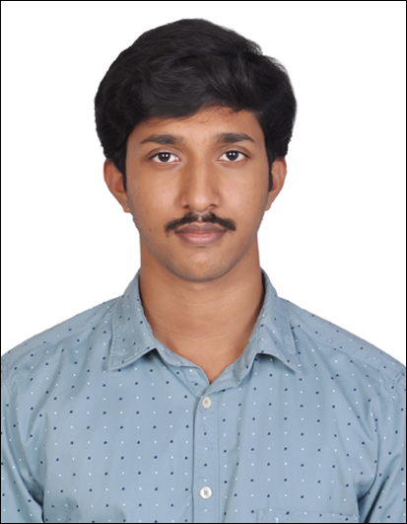

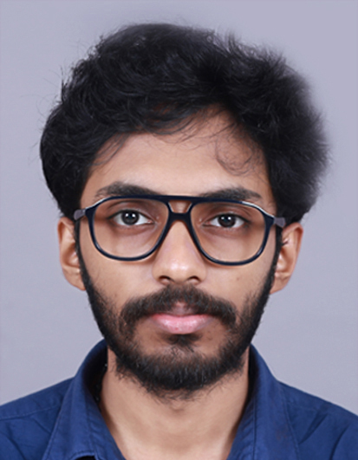
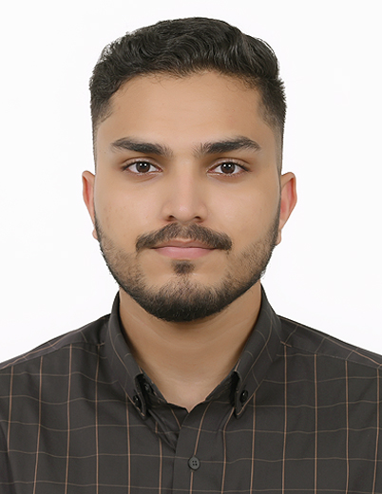
About our Team
Team Leader
Input Data Analyst/
Data Acquisition
Conceptiual Model
Chief Software Architect
Experiment Designer
Validation and Quality Control

Slide 4

Assessment and Quality Criteria
Don’t ignore member’s questions/needs/opinions
Voting if we can’t agree by discussing
Tell others if we are unhappy/in trouble
Hand in work ASAP
Catch up on other’s work
Pull our weight reliably
Inform if unavailable
Prepare for the Teammeeting

Slide 5
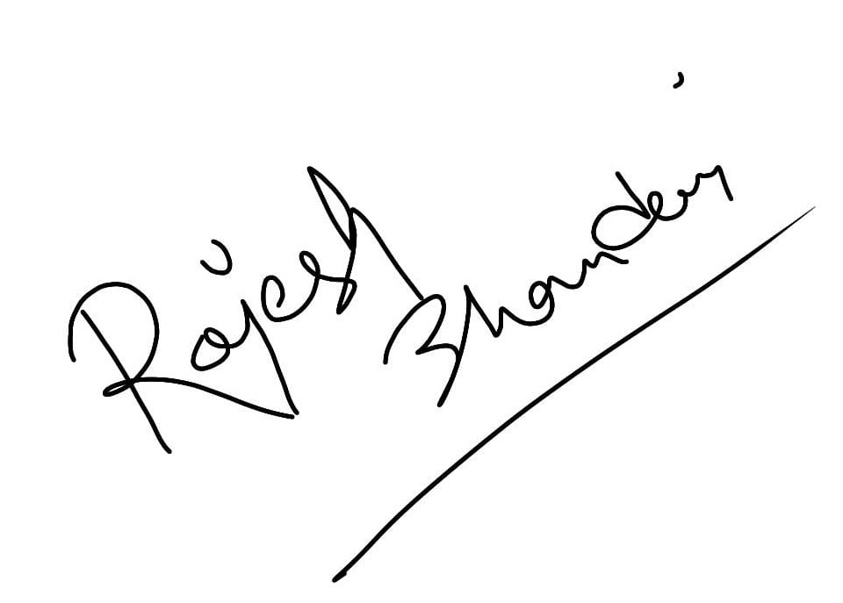
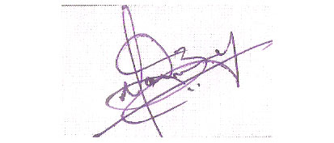
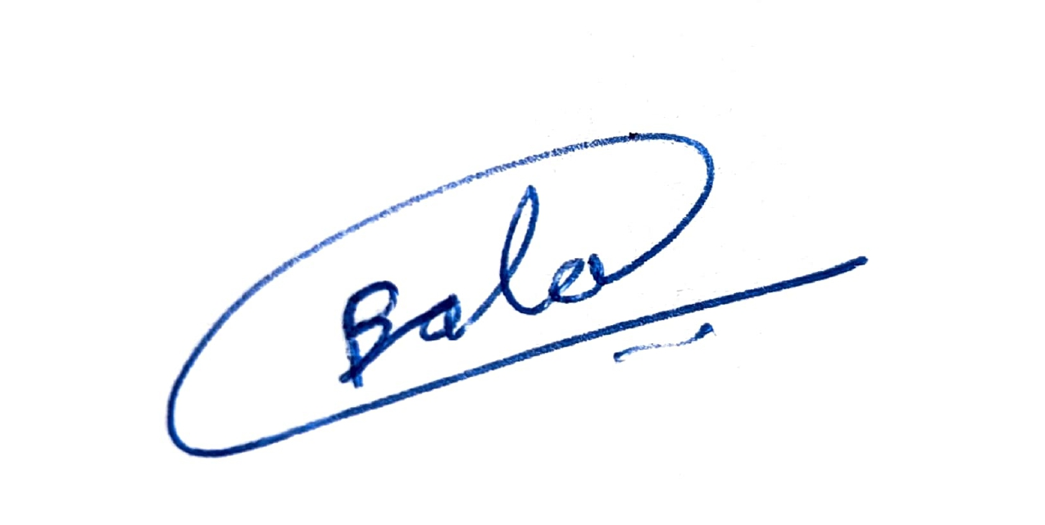
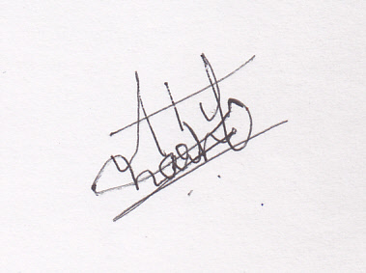
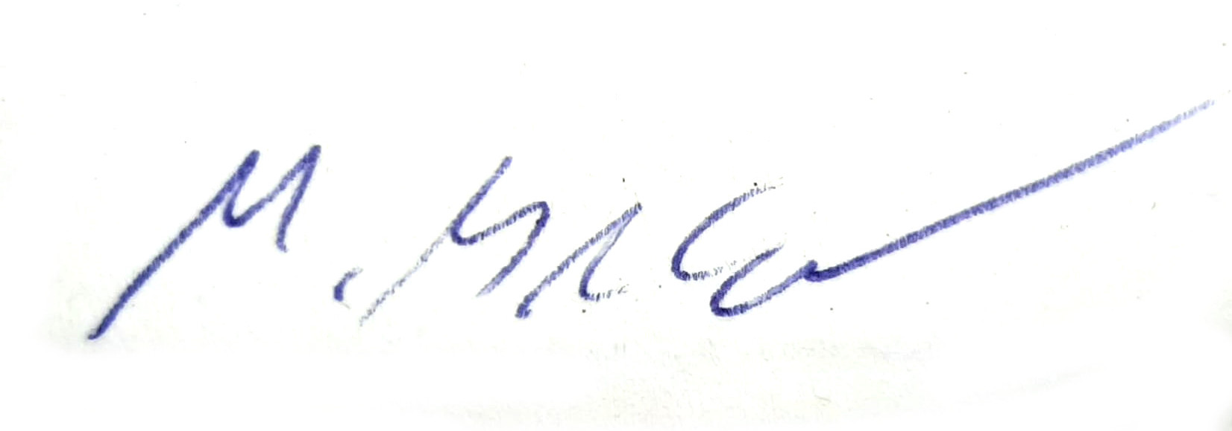
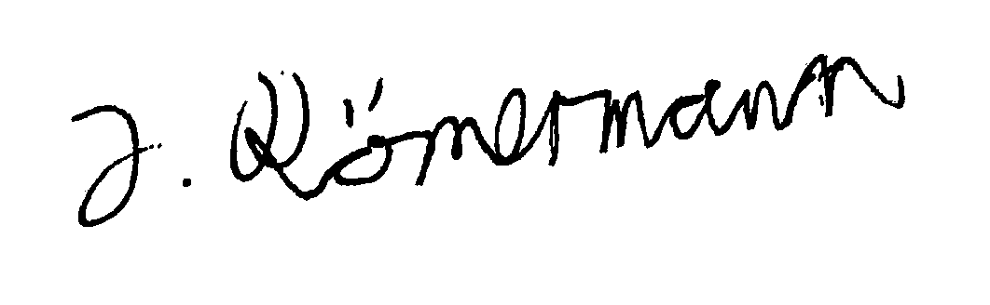
Team Goal
Our project goal is to finish the Simulation project with a good grade for every member. We will apply our mostly theoretical knowledge gained in the Introduction to Simulation course into practical use. We will overcome any hurdle that may be in our way by working together and combining our strenghts. We will grow and develope new skill both professional and in teamwork.
Everyone agrees to our list of performance criteria to be a valuable member and communicate properly. For our meetings we will be prepared and mind the time planned for each section by the teamlader. We are also willing to shelf our our agenda in favor of more pressing issues that need to be discussed in person.

Slide 6



Keeping in Touch

Slide 7
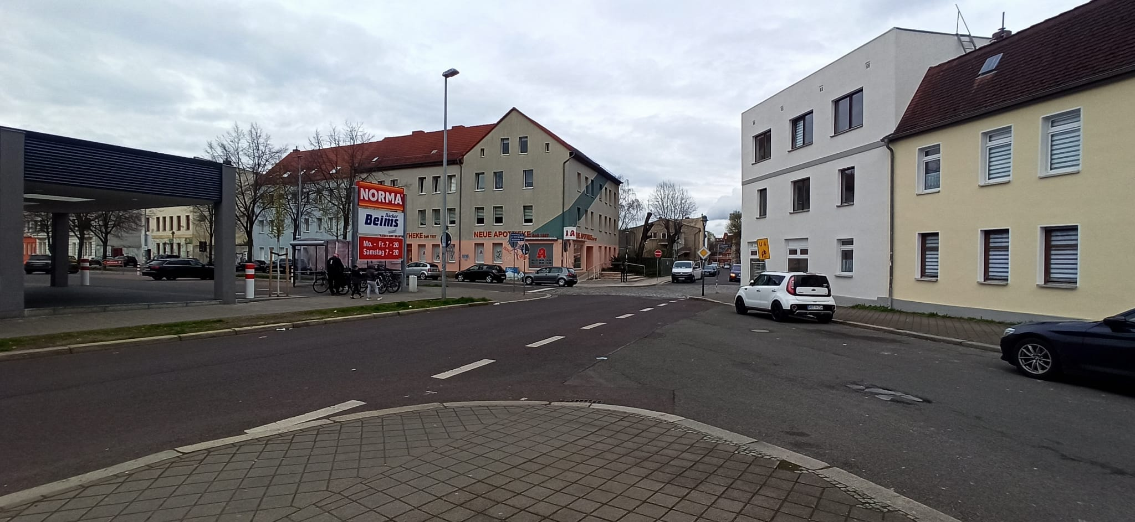
The Traffic Node

Slide 8
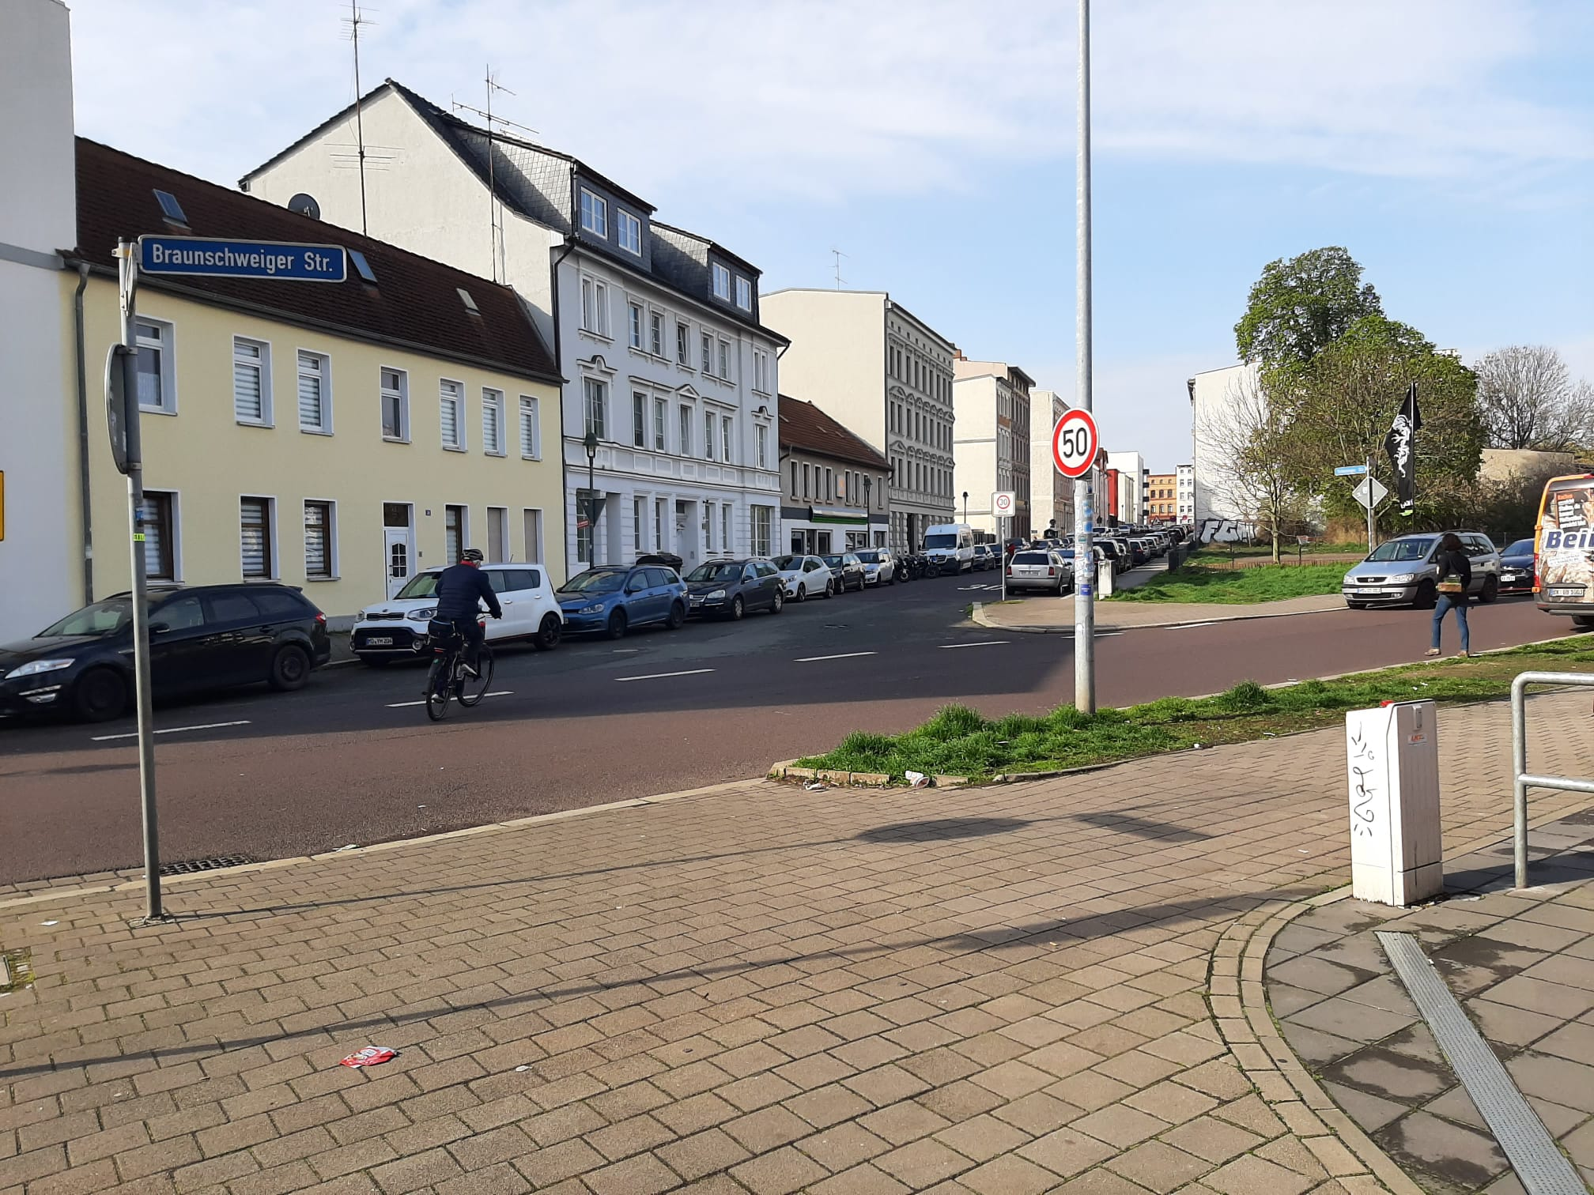
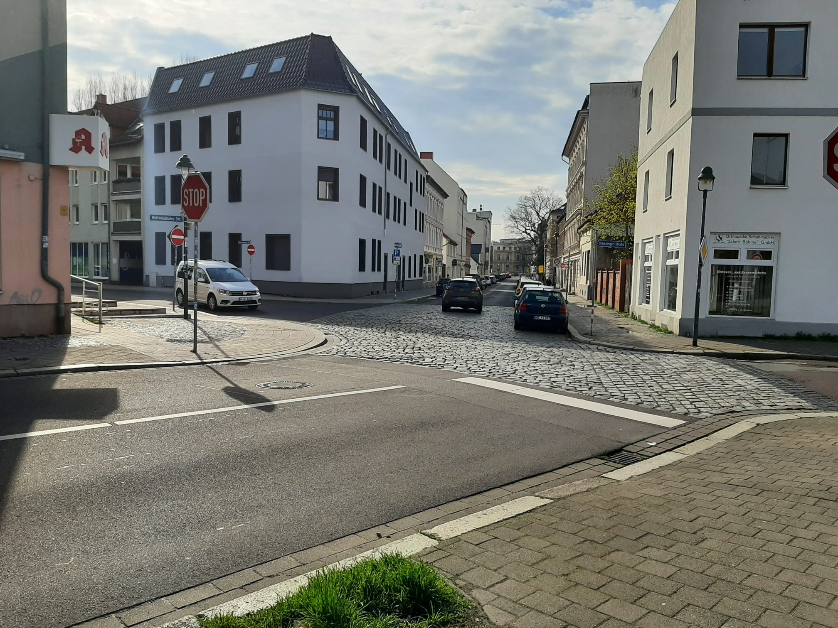
The Traffic Node

Slide 9
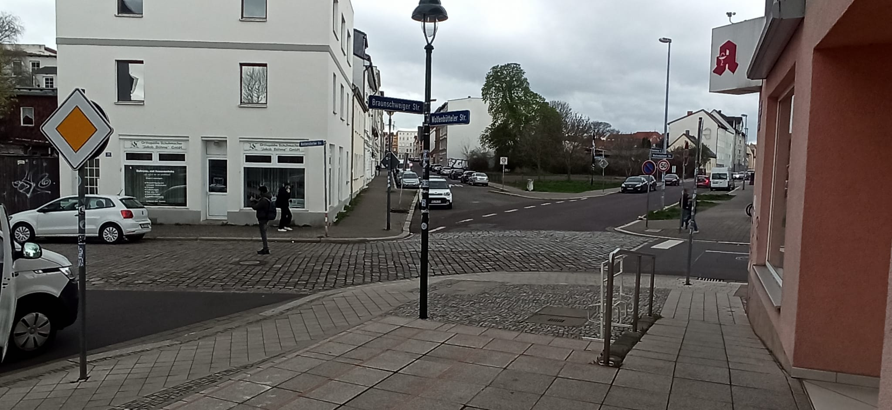
The Traffic Node

Slide 10

Data and Experiments
Data Needed
Inter-Arrival times of cars heading towards the node
(→ Waiting Time, Throughput)
Number of cars leaving the node in X time
(Validation)
Time cars spend in the node
(Service Times)
Number of cars turning to any direction
(Probabilities)
Road signs
(Design)

Slide 11
Data and Experiments
Planned Experiments
Best Troughput/Waiting Time between crossroads and roundabout with and without one/two one-way streets (several Experiments or ANOVA)
Performance crossroads (and roundabout) with increased traffic
Best at clearing traffic jam
Feeding five or four steers into the roundabout (combine 2)

Slide 12
Sources
https://de.wikipedia.org/wiki/WhatsApp#/media/Datei:WhatsApp.svg
https://en.wikipedia.org/wiki/Discord#/media/File:Discord_logo.svg
https://tr.wikipedia.org/wiki/GitHub#/media/Dosya:Font_Awesome_5_brands_github.svg
https://cdn.pixabay.com/photo/2018/01/31/05/43/web-3120321__480.png
https://cdn.pixabay.com/photo/2022/01/05/01/39/teamwork-6916252_960_720.jpg
https://cdn.pixabay.com/photo/2016/03/31/15/14/clock-1293099__340.png

